Slide 1
Chloroplastic photorespiratory bypass increases photosynthesis and biomass production in Arabidopsis thaliana
Rashad Kebeish, Markus Niessen, Krishnaveni Thiruveedhi, Rafijul Bari, Heinz-Josef Hirsch,
Ruben Rosenkranz, Norma Stäbler, Barbara Schönfeld, Fritz Kreuzaler & Christoph Peterhänsel

Slide 2
Introduction
Many important crops are C₃ plants
CO₂ fixation catalysed by rubisco*
Rubisco is particularly inefficient
*ribulose-1,5-bisphosphate carboxylase/ oxygenase

Slide 3
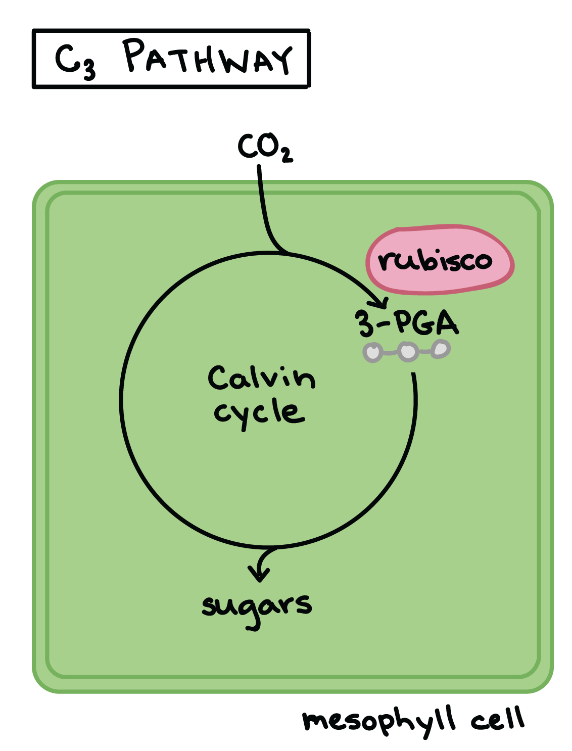
C₃ plants
Similarity: same metabolic pathway for carbon fixation in photosynthesis
Examples: rice , wheat , barley , soybean, peanut, cotton, tobacco, spinach, potato
https://www.khanacademy.org/science/biology/photosynthesis-in-plants/photorespiration--c3-c4-cam-plants/a/c3-c4-and-cam-plants-agriculture
Source: http://www.cropsreview.com/c3-plants.html

Slide 4
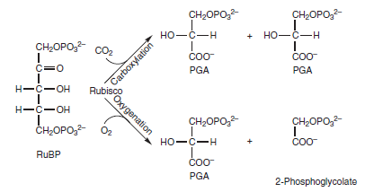
Rubisco
Can catalyze two reactions:
→ carboxylation of ribulose-1,5-bisphosphate
product: two phosphoglycerate (→ Calvin cycle)
→ oxygenation of ribulose-1,5-bisphosphate
product: phosphoglycerate and phosphoglycolate
Balance between both activities depends on O₂/CO₂ ratio in leaves
http://i18.servimg.com/u/f18/17/30/76/23/yuiyui13.png

Slide 5
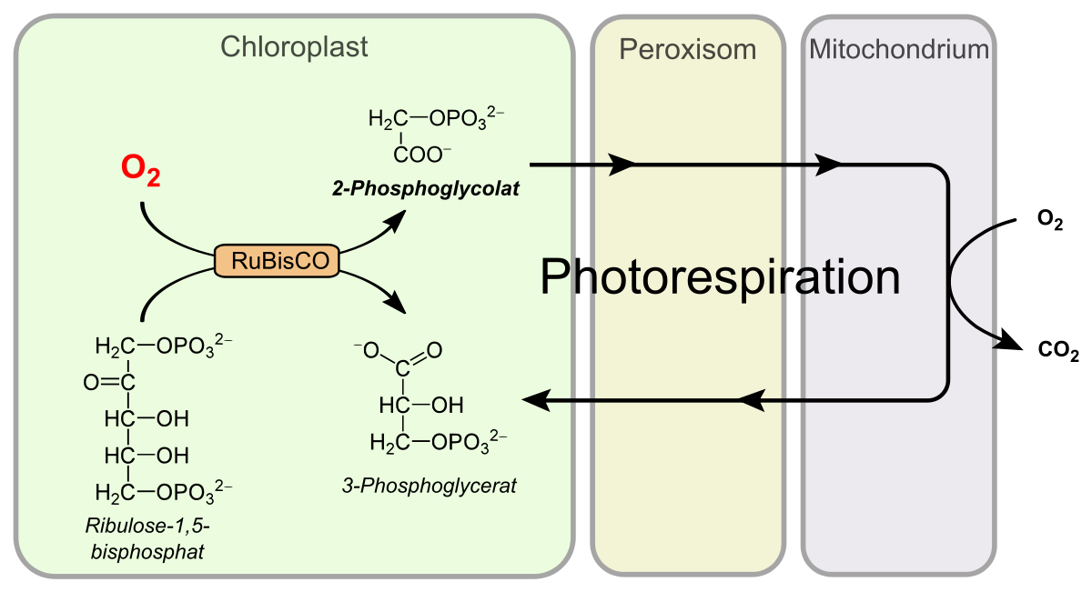
Phosphoglycolate
Recycled into phosphoglycerate by photorespiration
Ammonia is also lost in the reaction and needs to be refixed under energy consumption

Slide 6
Improvement opportunities
Doubling of CO₂ concentration (in glasshouse environment)
→ increasing performance
→ not possible in the field
Photorespiratory bypass
→ effects studied in this paper

Slide 7
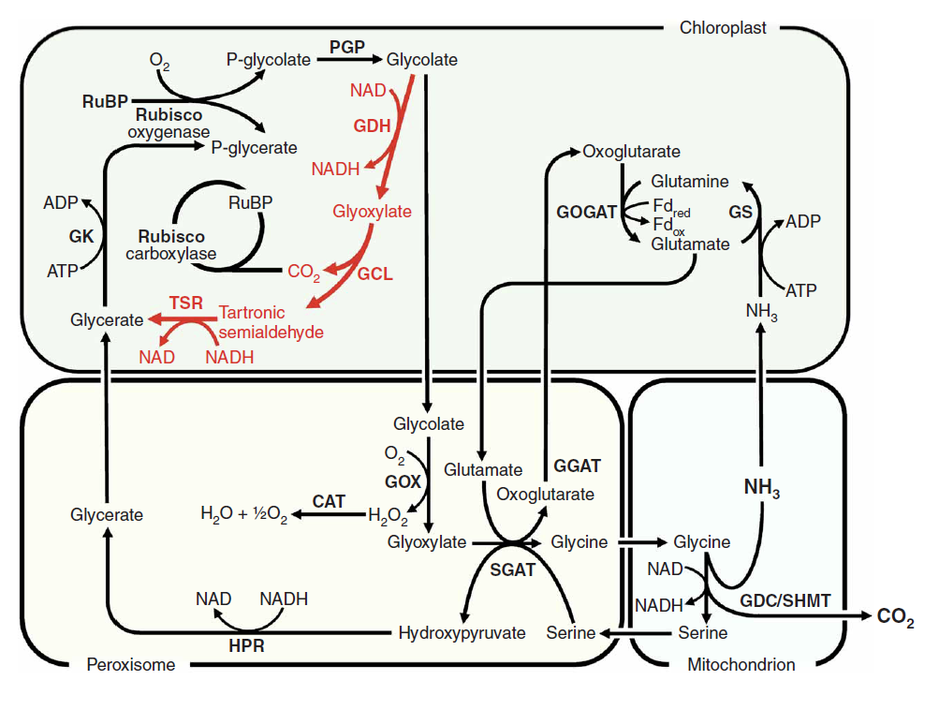
Photorespiratory bypass
E. coli glycolate pathway (shown in red)
3 enzymes:
→ glycolate dehydrogenase (GDH)
→ glyoxylate carboxyligase (GCL)
→ tartronic semialdehyde reductase (TSR)
GDH has three subunits
→ D, E, F
http://www.esalq.usp.br/lepse/imgs/conteudo_thumb/Chloroplastic-photorespiratory-bypass-increases-photosynthesis-and-biomass-production-in-Arabidopsis-thaliana.pdf

